Slide 1
MARKETING ANALYTICS I
SESSION 5:
Discrete Choice Models
UT Austin MSBA Program
Professor Sonnier
Fall 2022

Slide 2
BINARY OUTCOMES
From Shades of Grey to Black and White
Did You…
Purchase in the cereal category?
Enroll in college?
Stay with your bank?
Respond to a marketing email?
Click on a display ad?
These examples are all…
revealed preference data
Binary outcomes (1/0)
What about stated preference data

Slide 3
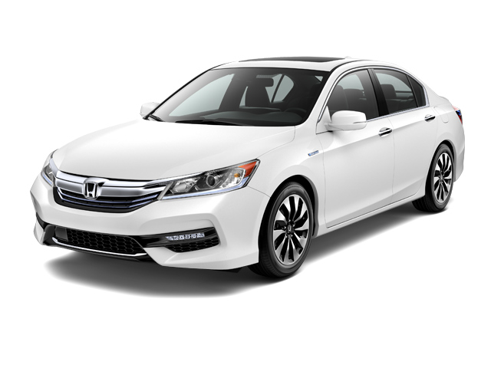
DISCRETE CHOICE
Choice in a Conjoint Task
Would you purchase this vehicle?
Honda
200HP V6
$25,000
Yes
No

Slide 4
BINARY OUTCOMES
Data for Respondent 1
I would like to say something about the probability of the respondent buying
I also would like to know how does the probability change when an attribute level changes (i.e., Toyota vs. Honda or $27K vs. $25K)

Slide 5
BINARY OUTCOMES
Let’s Just Do OLS for Respondent 1
Are beta coefficients marginal probabilities?

Slide 6
BINARY OUTCOMES
Let’s Just Do OLS for Respondent 1
Are the predicted values probabilities?
Does more data solve the problem?

Slide 7
BINARY OUTCOMES
OLS Regression: All Respondents
More signal in full sample

Slide 8
BINARY OUTCOMES
OLS Regression: All Respondents
Max predicted y: 0.88
Min predicted y: 0.14
Am I lucky or am I good?

Slide 9
BINARY OUTCOMES
OLS Regression: All Respondents

Slide 10
BINARY OUTCOMES
OLS Regression: All Respondents

Slide 11
BINARY OUTCOMES
Three Problems with OLS on Binary Outcomes
Predicted values are not probabilities
Model residuals are not normally distributed
Model residuals do not have constant variance

Slide 12
BINARY OUTCOMES
School Choice Data from Reading

Slide 13
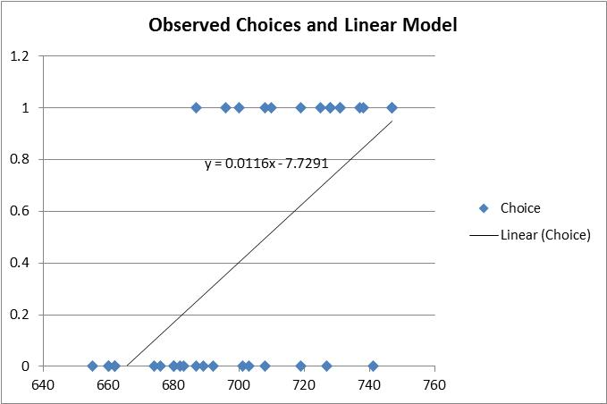
BINARY OUTCOMES
OLS on School Choice Data

Slide 14
BINARY OUTCOMES
School Choice Example (from reading)
Event of Interest: Did person choose H? (Yes or No)
I want to make statements about the probability that a person chose H
I need a model that describes behavior
I need to turn behavioral model into a statistical model

Slide 15
DISCRETE CHOICE THEORY
The Consumer and the Marketing Analyst
Behavioral Model
Statistical Model
Part of utility we can model or explain (i.e. deterministic)
Randomly distributed error term

Slide 16
DISCRETE CHOICE THEORY
Two Important Properties of Discrete Choice Models
Only differences in utility matter
Adding a constant amount of utility to each alternative does not change utility maximizing choice
The scale of utility is irrelevant
Multiplying each alternative by a constant amount of utility does not change utility maximizing choice

Slide 17
BINARY OUTCOMES
School Choice Example (from reading)
Event of Interest: Did person choose H? (Yes or No)
Absent any information on GMAT, what is your best guess for the probability that H is chosen by a given respondent?
How do we bring in the GMAT information? Let’s ask Prof. McFadden!

Slide 18
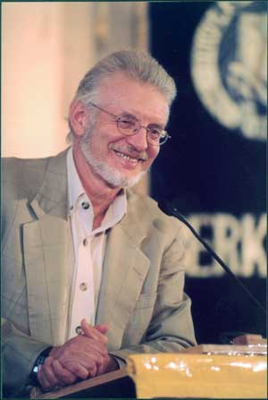
DISCRETE CHOICE
The Logit Model, or How to Win a Nobel Prize
Choose H
Choose Not H
I want to know the probability that a person chooses H given the GMAT scores
Given the data I can form the utility
I need to go from the utilities to the probabilities
Utility from Choosing H
Utility from Choosing Not H

Slide 19
DISCRETE CHOICE
The Logit Model, or How to Win a Nobel Prize
Choose H
Choose Not H

Slide 20
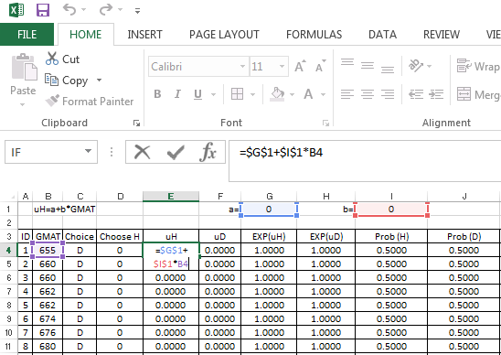
DISCRETE CHOICE
What is the Likelihood of the Observed Data?
I don’t know alpha and beta yet
Let me take an initial guess
Use initial guess to compute utilities

Slide 21
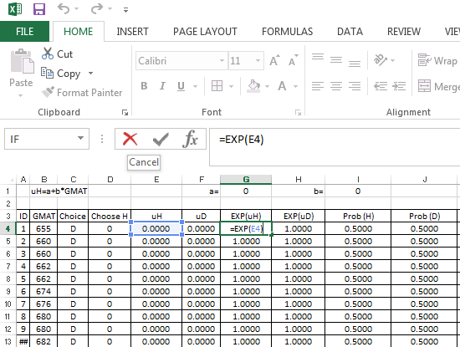
DISCRETE CHOICE
What is the Likelihood of the Observed Data?
Take the exponential of the utilities

Slide 22
DISCRETE CHOICE
What is the Likelihood of the Observed Data?
Use the exponentiated utilities and the formulas for the probabilities
Choose H
Choose Not H

Slide 23
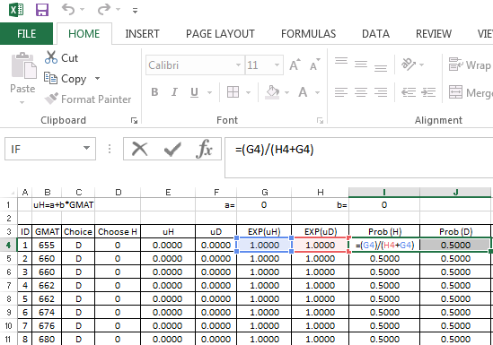
DISCRETE CHOICE
What is the Likelihood of the Observed Data?
Use the exponentiated utilities and the formulas for the probabilities
First for the probability of choosing H

Slide 24
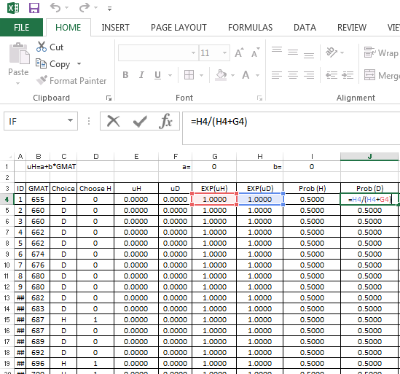
DISCRETE CHOICE
What is the Likelihood of the Observed Data?
Use the exponentiated utilities and the formulas for the probabilities
Then for the probability of not choosing H

Slide 25
DISCRETE CHOICE
What is the Likelihood of the Observed Data?
I see whether you enrolled in H or not
Your likelihood is the probability of whichever event I observe for you
The total likelihood of the data is the product of all the individual likelihoods

Slide 26
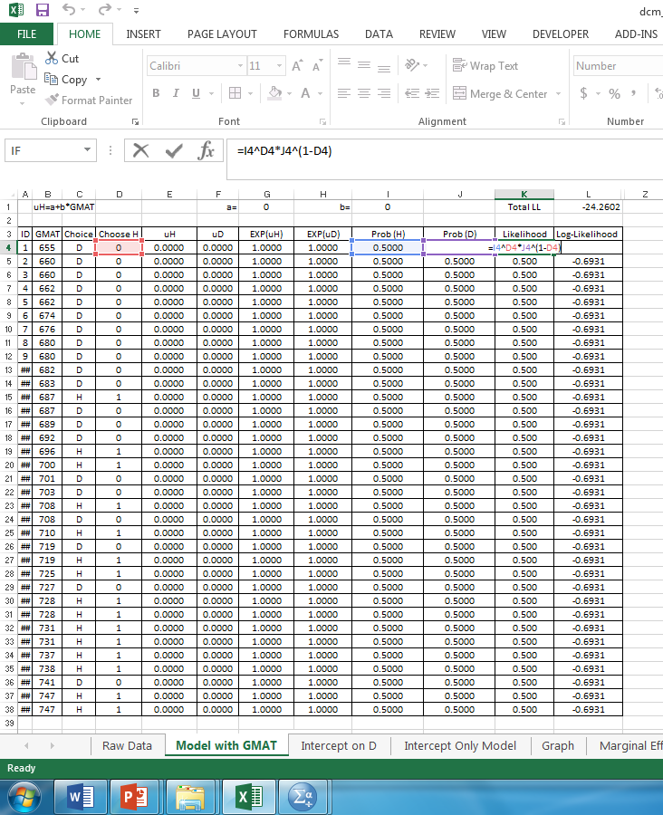
DISCRETE CHOICE
What is the Likelihood of the Observed Data?

Slide 27
DISCRETE CHOICE
Steps to Perform ML Estimation of Logit Model
Take initial guess at a and b (zero works!)
Compute utilities
Exponentiate utilities
Compute choice Probabilities
Compute likelihood of each observation
Take logs
Sum log likelihood
Let computer search to find a and b to maximize log-likelihood

Slide 28
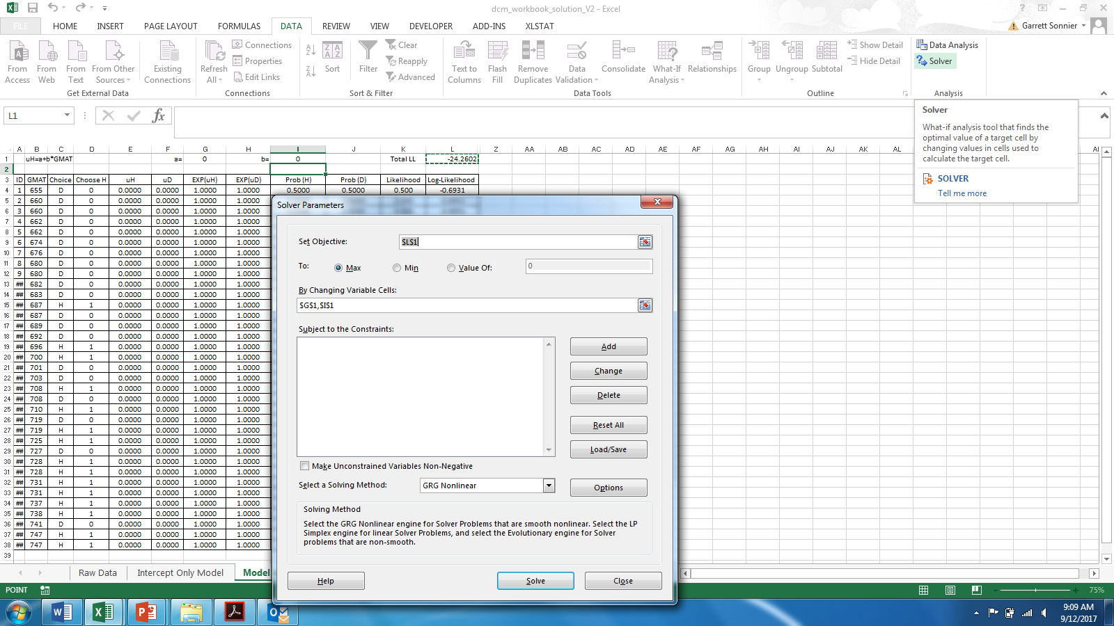
DISCRETE CHOICE
Steps to Perform ML Estimation of Logit Model

Slide 29
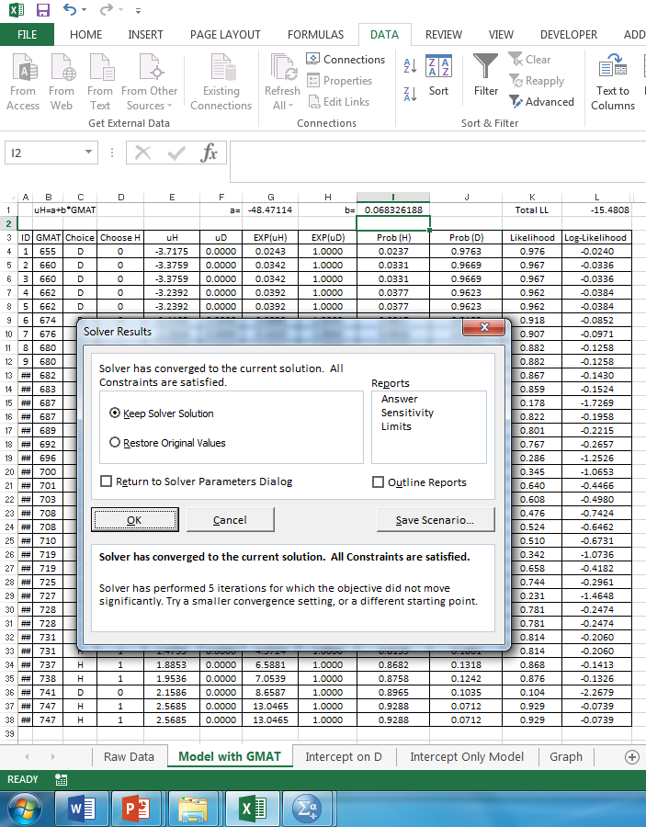
DISCRETE CHOICE
Sweet Results!

Slide 30
DISCRETE CHOICE
Results of ML Estimation of Logit Model
Estimate of a: -48.471
Estimate of b: 0.07
Note the probabilities

Slide 31
DISCRETE CHOICE
The Role of the Intercept
Does it matter where the intercept is placed in the model?
Choose H
Choose Not H

Slide 32
DISCRETE CHOICE
Results of ML Estimation of Logit Model
What happens if I put the intercept on “Choose Not H”

Slide 33
DISCRETE CHOICE
Results of ML Estimation of Logit Model
Estimate of a: 48.44
Estimate of b: 0.07
Note the probabilities
Where you put the intercept does not matter (up to a rounding error)
Put it where it is most convenient
Some software won’t even give you a choice

Slide 34
DISCRETE CHOICE
The Role of the Intercept
What happens if I run a model with only an intercept?
Choose H
Choose Not H

Slide 35
DISCRETE CHOICE
Results of ML Estimation of Logit Model
What happens if I have only an intercept in the model (i.e., no GMAT)

Slide 36
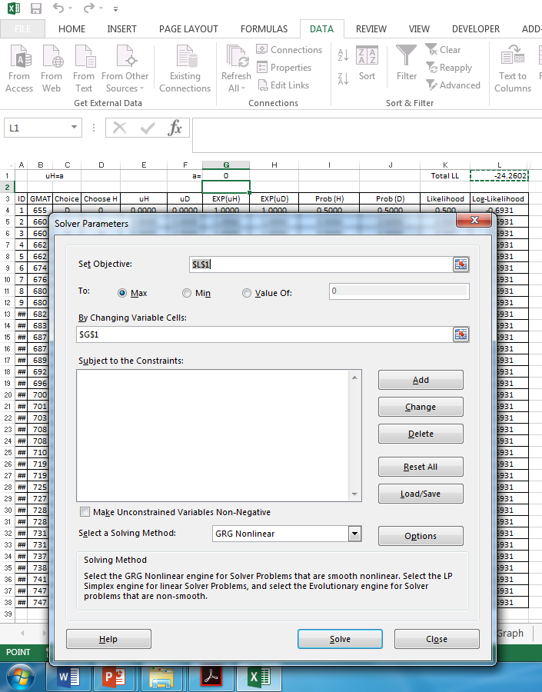
DISCRETE CHOICE
Results of ML Estimation of Logit Model

Slide 37
DISCRETE CHOICE
Results of ML Estimation of Logit Model
What happens if I have only an intercept in the model (i.e., no GMAT)
Estimate of a: -0.2877
Note the probabilities

Slide 38
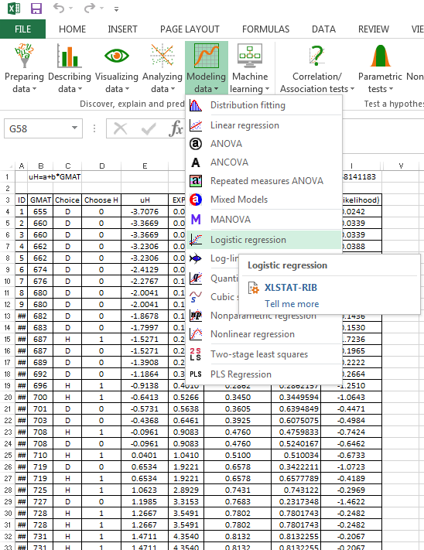
DISCRETE CHOICE
Binary Logit in XL Stat

Slide 39
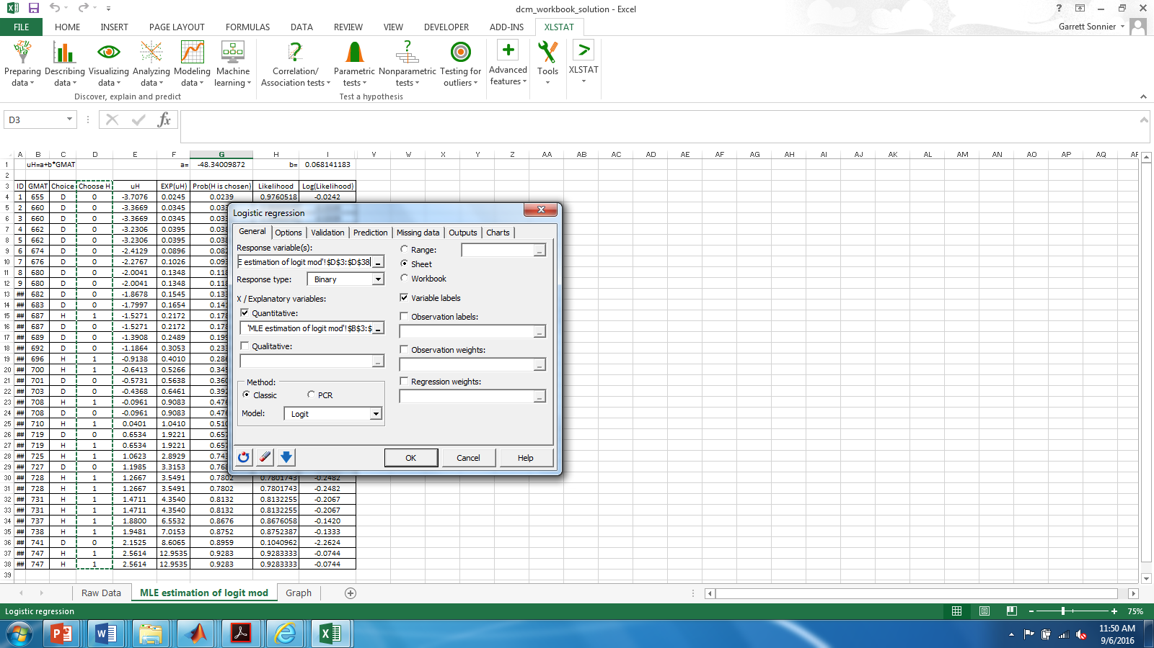
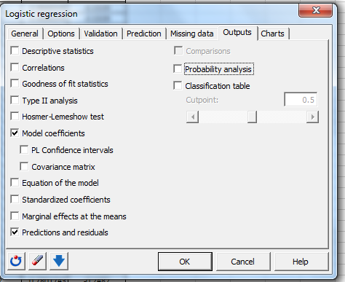
DISCRETE CHOICE
Binary Logit in XL Stat
Select “Choose H” as response variable
Select “binary” as response type
Select “GMAT” as X
Select “Logit” as Model
No need to compute utilities or probabilities

Slide 40
DISCRETE CHOICE
In XLSTAT

Slide 41
DISCRETE CHOICE
Results of ML Estimation of Logit Model
Estimate of a: -48.471
Estimate of b: 0.07
Note the probabilities

Slide 42
MARKETING ANALYTICS
Key Concepts for Discrete Choice Models
OLS is not well suited to the analysis of discrete choice
By combining behavioral and statistical models we can compute the probability of observing discrete outcomes (i.e., probability of enrollment) conditional on relevant covariates (i.e., GMAT score)
Model parameters are estimated via Maximum Likelihood
Model likelihood and choice probabilities are invariant to where the intercept is specified
Model with only an intercept returns probabilities corresponding to the observed frequency of choice

